Slide 1

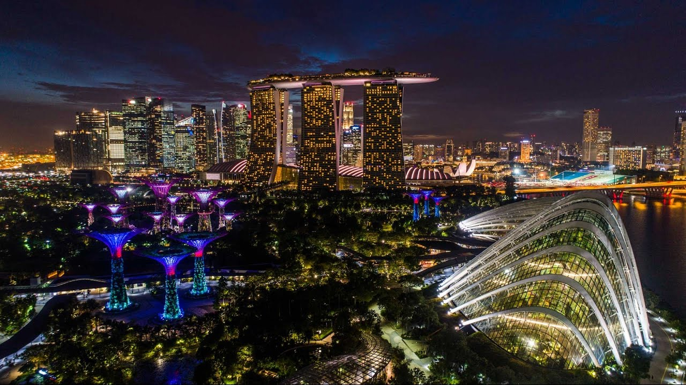
RESEARCH BASED PRESENTATION // 2026
Singapore Real Estate for
US-Based Investors
Opportunities, Constraints, and Realities
PREPARED FOR: US-BASED INVESTORS DATE: MARCH 2026
Notes:
Today I’ll be discussing Singapore’s residential property market from the perspective of US-based investors.
The objective of this session is to provide a clear and structured overview of how the market works — not just the opportunities, but also the constraints and regulatory realities.
Singapore is often viewed internationally as a stable and attractive real estate market, but the system here operates very differently from many other countries.
Government policy plays a significant role in shaping the housing market, and understanding that framework is essential before making any investment decisions.
So the goal today is to walk through the structure of the market, the regulatory environment, the pricing dynamics, and what a typical investment might look like in practice.

Slide 2





LEGAL NOTICE // DISCLAIMER-01
Disclaimer
EDUCATIONAL_DISCUSSION_ONLY
Educational discussion only
Not financial or investment advice
Regulations and taxes may change
Consult licensed professionals before investing
PAGE: 02
Notes:
Before we begin, a quick disclaimer.
This presentation is intended purely as an educational discussion about the Singapore property market.
Nothing here should be interpreted as financial advice or a recommendation to buy or sell any property.
Regulations, tax policies, and market conditions in Singapore can change over time, sometimes quite quickly depending on policy decisions.
So any investor considering entering the market should consult licensed professionals such as property lawyers, financial advisors, and tax specialists before making decisions.
What I’ll focus on today is helping you understand the structure and mechanics of the market so you can evaluate it properly.

Slide 3
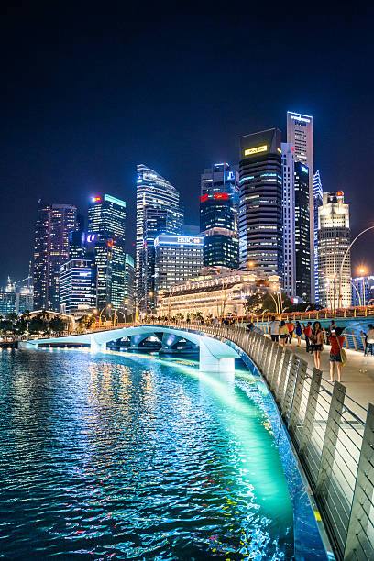

NARRATIVE // 01
Why Singapore?
A Personal Perspective
Having grown up in Singapore and spent much of my career in the real estate industry, I’ve had the opportunity to observe how the city’s housing market has evolved over time.
What makes Singapore unique is the way policy, urban planning, and market demand intersect to shape the property landscape.
This creates a market that is highly regulated, yet remarkably transparent and resilient, which is why it continues to attract global capital.
PAGE: 03
Notes:
I was born and raised in Singapore, so I’ve seen the city evolve quite dramatically over the years.
What started as a regional trading hub has transformed into one of the world’s major financial and business centres.
Through my work in the property industry, I’ve had the opportunity to observe how Singapore’s housing market behaves across different policy cycles and economic periods.
One thing that makes Singapore particularly unique is the interaction between government planning and market forces.
The market is highly regulated, but at the same time very transparent and predictable, which is not always common in global real estate markets.
That combination of institutional stability, strong governance, and long-term planning is one of the reasons Singapore continues to attract international investors.
So in this presentation, I’ll walk through how this system works and what it means for investors looking at Singapore’s residential property market.

Slide 4



INVESTOR PROFILE // AUDIENCE-01
Who This Discussion Is For
TARGET_INVESTOR_CRITERIA
Based in the United States
Exploring cross-border real estate exposure
Investment capital: USD 800k – USD 2.5M
Investment first, potential personal use later
PAGE: 04
Notes:
This discussion is specifically framed for US-based investors who may be exploring international real estate exposure.
Typically we see investors looking at Singapore with capital allocations between about USD 800,000 and USD 2.5 million.
At that range, investors are usually looking at private residential condominiums rather than landed properties.
In many cases the motivation is investment first, with potential personal use later, such as a future relocation, children studying in Asia, or diversification of global assets.
Singapore is particularly interesting because it offers political stability, strong property rights, and a very transparent transaction system, which are important considerations for cross-border investors.

Slide 5

PRESENTATION ROADMAP // STRUCTURE-01
Structure of the Presentation
MODULE_01
MODULE_02
Singapore Context
Market Structure
Economic structure, institutional stability, and bilateral ties with the United States.
Housing segments, land scarcity, and the private residential landscape.
MODULE_03
MODULE_04
Pricing & Affordability
Investment Potential
Regional price ranges, budget examples, and long-term historical trends.
Rental yield benchmarks, demand drivers, and capital appreciation factors.
MODULE_05
MODULE_06
Legal & Tax Framework
Case Study & Risks
ABSD rates, FTA advantages, property taxes, and the purchase process.
Financial model breakdown, stress test scenarios, and key risk factors.
PAGE: 05
Notes:
To make the discussion easier to follow, I’ve structured the presentation into six main sections.
First, we’ll look at the Singapore context — the economic environment and why the city attracts global capital.
Second, we’ll examine the structure of the housing market, including the different residential segments and land scarcity dynamics.
Third, we’ll look at pricing and affordability, including how different regions of Singapore compare in terms of property prices.
Fourth, we’ll discuss investment potential, including rental yields and demand drivers.
Fifth, we’ll walk through the legal and tax framework, which is especially important for foreign investors.
Finally, I’ll show a case study and some risk scenarios, so we can understand what a real investment might look like in practice.

Slide 6





MARKET CONTEXT // OVERVIEW-01
Singapore at a Glance
DEMOGRAPHICS
GEOGRAPHY
~6.0 Million
~730 km²
Total population including a significant global talent pool and expatriate community.
Highly constrained land area driving inherent scarcity and strategic urban planning.
ECONOMICS
HUB_STATUS
AAA Rated
Global Hub
One of the highest GDP per capita globally with a robust, diversified economic base.
A primary financial and commercial gateway for the Asia-Pacific region.
PAGE: 06
Notes:
To understand the property market, it’s important to first understand the context of Singapore as a country.
Singapore has a population of roughly six million people, with a large proportion of expatriates and international professionals.
The entire country occupies only about 730 square kilometres, which means land is extremely scarce.
Because of this physical constraint, urban planning and land allocation are carefully managed by the government.
Economically, Singapore consistently ranks among the highest GDP per capita globally and has a very diversified economic base.
It also functions as a major financial and commercial gateway to the Asia-Pacific region, which is why many multinational companies base their regional operations here.
All of these factors play a significant role in shaping housing demand and long-term property values.

Slide 7







ECONOMIC STRUCTURE // SECTORS-01
Major Industries & Economic Drivers
SECTOR_01
SECTOR_02
SECTOR_03
Financial Services
Technology
Manufacturing
Global hub for banking, asset management, and insurance.
Regional HQ for global tech giants and a thriving startup ecosystem.
High-value electronics, semiconductors, and precision engineering.
SECTOR_04
SECTOR_05
SECTOR_06
Logistics & Trade
BioMedical
Global Services
One of the world's busiest ports and a critical global trade node.
Leading center for pharmaceutical manufacturing and R&D.
Professional services, legal, and consulting for the APAC region.
PAGE: 07
Notes:
Singapore’s economy is highly diversified, which is one of the key reasons the property market tends to be relatively stable.
The country is widely known as a global financial hub, with major banks, asset managers, and financial institutions operating out of Singapore.
Technology is another rapidly growing sector, with companies like Google, Meta, Amazon, and Microsoft establishing regional headquarters here.
Singapore also maintains a strong advanced manufacturing base, particularly in semiconductors, electronics, and precision engineering.
Logistics and global trade remain critical pillars, supported by one of the world’s busiest ports and one of Asia’s major aviation hubs.
In addition, Singapore has developed into a major biomedical and pharmaceutical manufacturing centre.
Together, these sectors create a stable base of high-income employment, which directly supports housing demand.

Slide 8





BILATERAL TIES // SYNERGY-01
Singapore & the United States
POLICY_FRAMEWORK
MARKET_PRESENCE
Free Trade Agreement
Corporate Footprint
The US-Singapore FTA (USSFTA), in effect since 2004, is a cornerstone of the relationship, facilitating seamless capital and trade flows.
Over 5,000 US companies operate in Singapore, with many utilizing the city-state as their regional headquarters for Asia-Pacific operations.
Tax Reciprocity
Rental Demand Anchor
US citizens enjoy unique stamp duty treatments (ABSD) equivalent to Singapore Citizens, a benefit not extended to most other nationalities.
A significant American expatriate community provides a steady, high-quality demand base for the private residential rental market.
PAGE: 08
Notes:
Singapore and the United States share a very close economic relationship.
The two countries signed the US-Singapore Free Trade Agreement in 2004, which remains one of the most comprehensive bilateral agreements in the region.
One interesting implication of this agreement relates to real estate investment.
Under the FTA, US citizens are treated similarly to Singapore citizens for certain property tax rules, particularly the Additional Buyer’s Stamp Duty.
Singapore also hosts thousands of US companies, many of which use Singapore as their Asia-Pacific headquarters.
This creates a steady flow of American expatriates and international professionals, which contributes significantly to the private residential rental market.
In other words, the US presence in Singapore is not just financial — it also supports real estate demand directly.

Slide 9





INSTITUTIONAL FRAMEWORK // STABILITY-01
Rule of Law & Institutional Stability
PILLAR_01
PILLAR_02
Transparent Legal System
Contract Enforcement
Ownership rights are clearly defined, and property titles are well-documented within a robust, English-based legal framework.
Singapore consistently ranks among the top globally for contract enforcement and protection of intellectual and physical property.
PILLAR_03
PILLAR_04
Stable Governance
Low Corruption
Predictable policy-making and long-term strategic planning provide a stable environment for multi-decade capital allocation.
Consistently ranked as one of the least corrupt countries in the world, minimizing hidden costs and operational risks.
PAGE: 09
Notes:
One of Singapore’s biggest strengths as an investment destination is institutional stability.
Property ownership rights are clearly defined under a robust legal framework based on English common law.
The country consistently ranks among the top globally for contract enforcement and legal transparency.
Government policies are generally long-term and predictable, which reduces policy uncertainty compared to many emerging markets.
Singapore also ranks among the least corrupt countries in the world, which further strengthens investor confidence.
For real estate investors, this environment provides clarity, security, and transparency in property ownership and transactions.

Slide 10




REGULATORY ENVIRONMENT // POLICY-01
Government Role in Housing
LEVER_01
LEVER_02
Cooling Measures
Stamp Duties
Active use of Loan-to-Value (LTV) limits and Total Debt Servicing Ratio (TDSR) to prevent excessive leverage and market bubbles.
Strategic application of Buyer's Stamp Duty (BSD) and Additional Buyer's Stamp Duty (ABSD) to manage foreign and investment demand.
LEVER_03
LEVER_04
Land Supply Planning
Urban Development
The Government Land Sales (GLS) program regulates the release of land for private development to match long-term demand projections.
The Urban Redevelopment Authority (URA) ensures integrated planning, where infrastructure and amenities precede residential growth.
PAGE: 10
Notes:
Unlike many countries where housing markets are largely market-driven, Singapore’s government plays a very active role in housing policy.
One of the main tools used is cooling measures, such as loan-to-value limits and the Total Debt Servicing Ratio.
These policies are designed to prevent excessive leverage and reduce speculative bubbles in the property market.
The government also uses stamp duties, particularly Additional Buyer’s Stamp Duty, to regulate foreign and investment demand.
Another important mechanism is the Government Land Sales program, which controls how much land is released to developers.
Finally, the Urban Redevelopment Authority oversees long-term urban planning, ensuring infrastructure and amenities are developed alongside residential areas.
Together, these policies help maintain long-term stability in the housing market

Slide 11

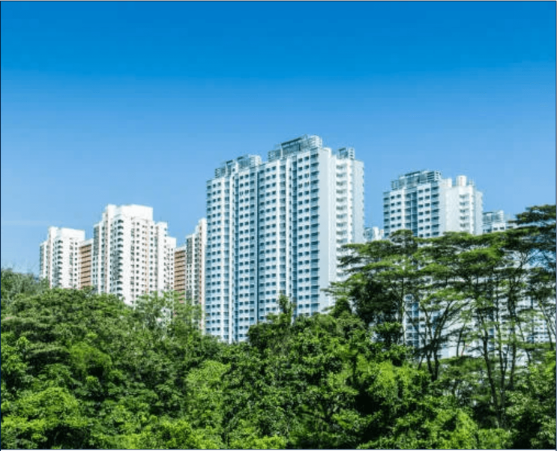
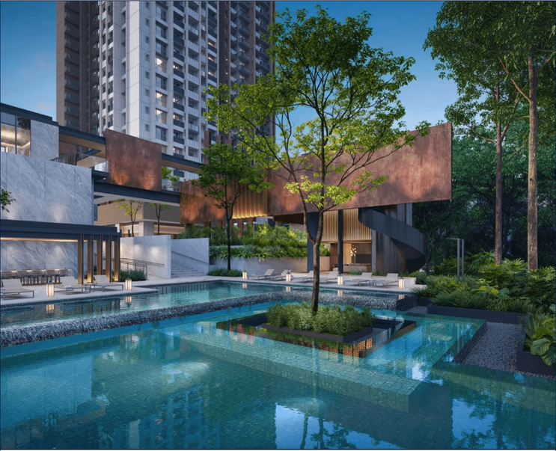
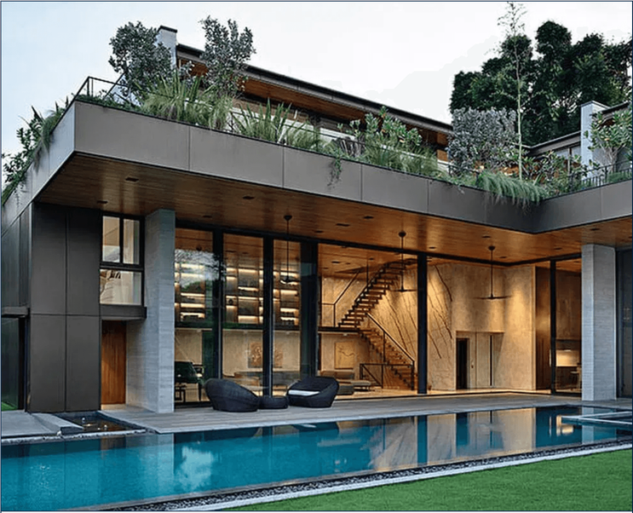
MARKET STRUCTURE // 01
Housing Market Structure
SEGMENT_01
SEGMENT_02
SEGMENT_03
Public Housing (HDB)
Private Condominiums
Landed Property
Government-built apartments housing ~78% of the population. Highly regulated resale market, restricted to citizens and permanent residents.
Full-facility developments (pools, gyms, security). The primary segment for foreign investors, offering high liquidity and standardized legal frameworks.
Terrace houses, semi-detached, and bungalows. Extremely scarce and generally restricted to Singapore citizens (LDAU approval required for foreigners).
PAGE: 11
Notes:
Singapore’s housing market is divided into three main segments.
The first is public housing, commonly known as HDB flats, where roughly three quarters of the population lives.
These units are heavily subsidized and regulated, and foreigners generally cannot purchase them.
The second segment is private condominiums, which include full-facility developments with amenities such as pools, gyms, and security.
This is the primary segment available to foreign investors.
The third segment is landed housing, which includes terrace houses, semi-detached houses, and bungalows.
These are extremely scarce and are mostly restricted to Singapore citizens

Slide 12

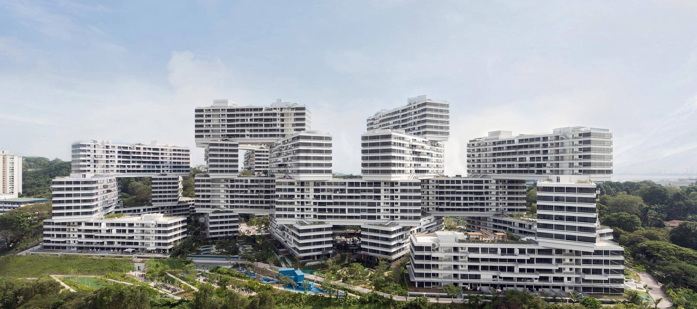
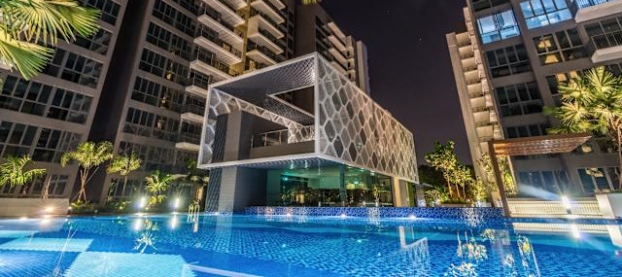
MARKET STRUCTURE // 02
Residential Properties Available to Foreign Buyers
SEGMENT_01
SEGMENT_02
Condominiums
Executive Condominiums
Includes private apartments and Executive Condominiums (ECs). ECs are a hybrid class that becomes fully privatized and open to foreigners after 10 years.
A hybrid public-private housing type initially restricted to citizens but fully privatized after 10 years, after which foreigners can purchase resale units.
PROJECT: SG-RE-2026
PAGE: 12
Notes:
For foreign investors, the main property category available is private non-landed residential property.
This includes condominiums and private apartments.
Condominiums typically include shared facilities such as swimming pools, gyms, and security.
These developments are governed under a strata title system, which makes ownership relatively standardized and transparent.
Another category worth mentioning is Executive Condominiums, often referred to as ECs.
These are a hybrid housing type that initially have ownership restrictions, but after 10 years they become fully privatized and open to foreign buyers.

Slide 13
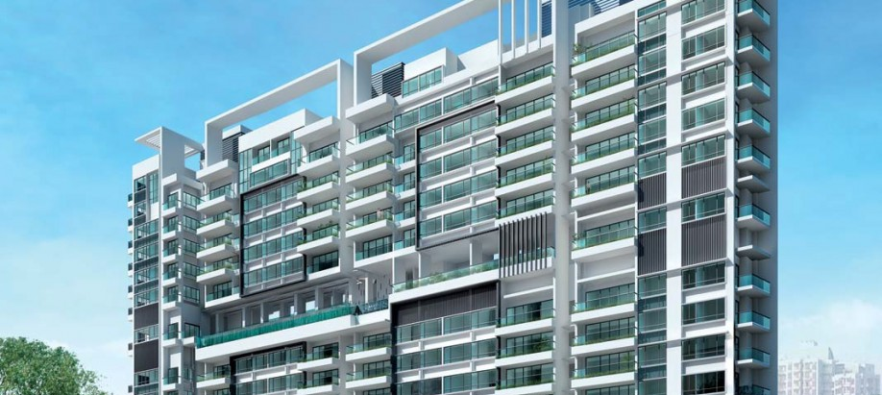
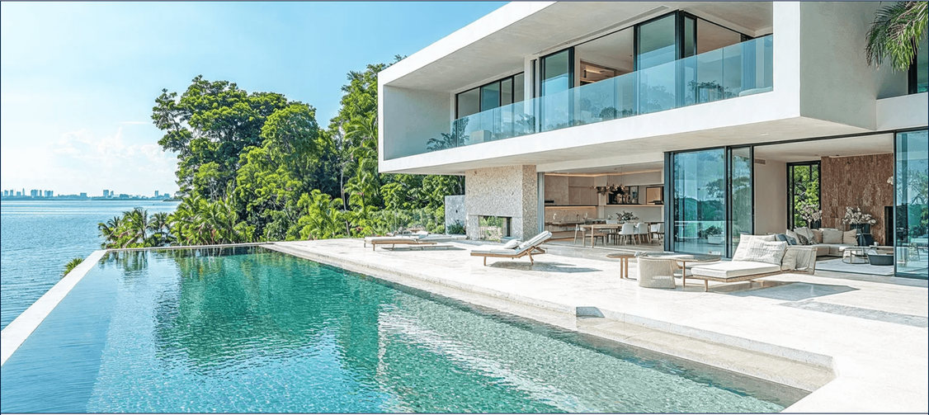
MARKET STRUCTURE // 02
Residential Properties Available to Foreign Buyers
SEGMENT_01
SEGMENT_02
Apartments
Sentosa Cove Landed
Private non-landed residential buildings similar to condominiums but typically with fewer facilities and smaller developments.
The only enclave in Singapore where foreigners can purchase landed property (bungalows/villas) without prior LDAU approval. A unique trophy asset class.
PROJECT: SG-RE-2026
PAGE: 13
Notes:
Private apartments are similar to condominiums but usually smaller developments with fewer shared facilities.
They still fall under the category of private non-landed residential property, so foreigners can purchase them freely.
The other interesting exception is Sentosa Cove landed property.
Sentosa Cove is a special enclave where foreigners are allowed to purchase landed houses such as villas and waterfront bungalows.
These properties are generally considered luxury trophy assets rather than typical investment properties.

Slide 14

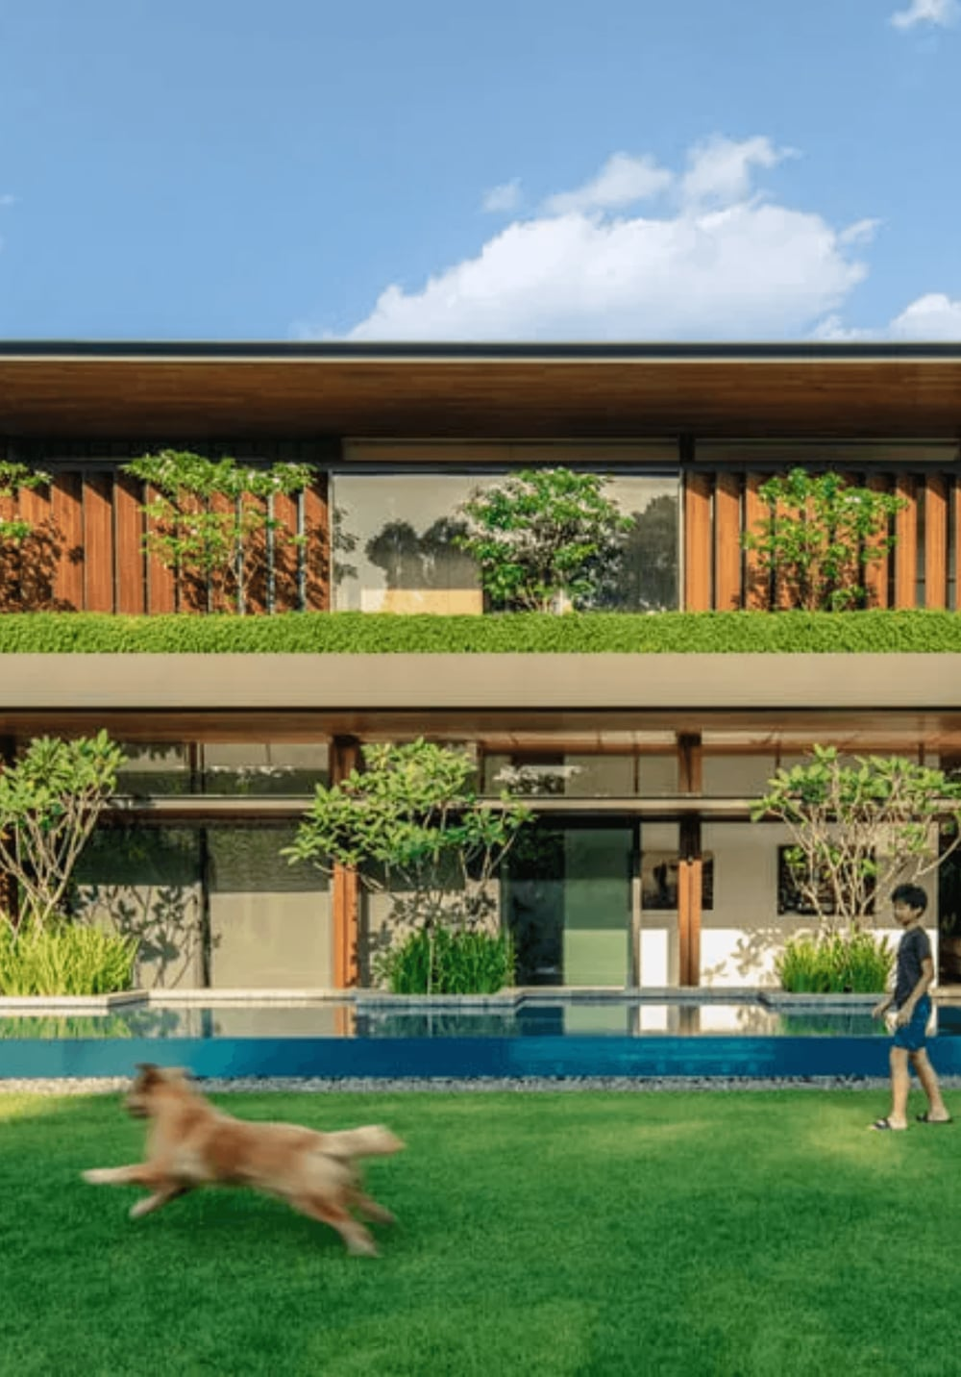
REGULATORY FRAMEWORK // 02
Restricted Properties: What Foreigners Cannot Buy Freely
Landed Houses (GCBs, Bungalows, Terrace)
Foreigners require LDAU approval, which is almost never granted. Approval typically requires exceptional economic contribution and PR status.
Public Housing (HDB Flats)
Foreigners cannot buy HDB flats. Even PRs can only buy resale HDBs with a PR or citizen spouse. Foreigners alone are entirely prohibited.
The LDAU Approval Reality
Approval is rare and reserved for high-net-worth individuals who have demonstrated significant long-term commitment to Singapore.
PAGE: 14
Notes:
While foreigners can buy private condominiums freely, most landed housing is restricted.
This includes terrace houses, semi-detached houses, and bungalows located on mainland Singapore.
Foreigners must obtain approval from the Land Dealings Approval Unit, which is rarely granted.
Approval usually requires permanent residency and significant economic contribution to Singapore.
Public housing is even more restricted.
Foreigners cannot buy HDB flats at all, and even permanent residents face certain limitations.

Slide 15





URBAN STRATEGY // SCARCITY-01
The Impact of Land Scarcity
PHYSICAL_LIMITS
STRATEGIC_PLANNING
Finite Land Area
URA Master Plan
With only 730 km² of land, Singapore faces extreme geographic constraints, making land the most valuable resource in the city-state.
A statutory 10-15 year roadmap that guides land use, ensuring infrastructure and amenities precede residential growth.
High Urban Density
Infrastructure-Led Value
Careful management of density is required to balance residential, commercial, and industrial needs within a limited footprint.
Property values are strongly linked to government-led infrastructure projects, such as new MRT lines and regional commercial hubs.
PAGE: 15
Notes:
One of the most important structural drivers of Singapore’s property market is land scarcity.
The entire country occupies only about 730 square kilometres, so land is a finite resource.
This means every parcel of land must be carefully allocated between residential, commercial, industrial, and infrastructure uses.
Urban density is therefore carefully managed through long-term planning.
The URA Master Plan, which looks 10 to 15 years ahead, guides how land will be developed across the country.
Infrastructure investments such as new MRT lines, regional business hubs, and transport links often play a major role in driving property values.

Slide 16

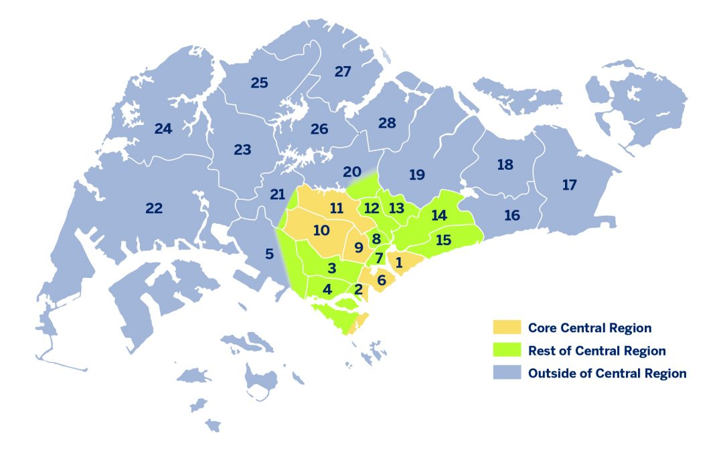
MARKET PERFORMANCE // 01
Residential Regions
Core Central Region
Singapore’s prime central districts such as Orchard and Marina Bay, with the most expensive luxury developments and strong appeal to global investors.
Rest of Central Region
City-fringe districts surrounding the core, offering a balance between central accessibility, livability, and relative value.
Outside of Central Region
Suburban residential areas further from the city center, typically with lower entry prices and demand driven mainly by local buyers.
PAGE: 16
Notes:
Singapore’s private residential market is commonly divided into three geographic regions, which investors often use to evaluate property opportunities.
The first is the Core Central Region, or CCR. These are the prime districts located in the traditional city centre, including areas like Orchard Road, Marina Bay, and the Downtown Core.
Properties in these districts tend to be luxury developments with the highest price levels in Singapore.
The second category is the Rest of Central Region, or RCR. These are city-fringe districts that surround the central core.
Examples include areas such as Queenstown, Tiong Bahru, and Kallang. These locations are often very popular with expatriates due to their proximity to the CBD while still offering more space and value.
The final category is the Outside Central Region, or OCR. These are suburban residential areas such as Tampines, Jurong, and Woodlands.
OCR properties generally have lower entry prices and demand driven mainly by local buyers

Slide 17
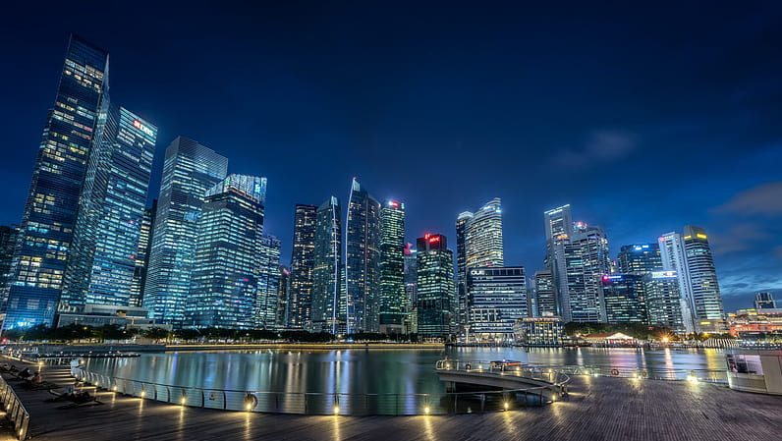
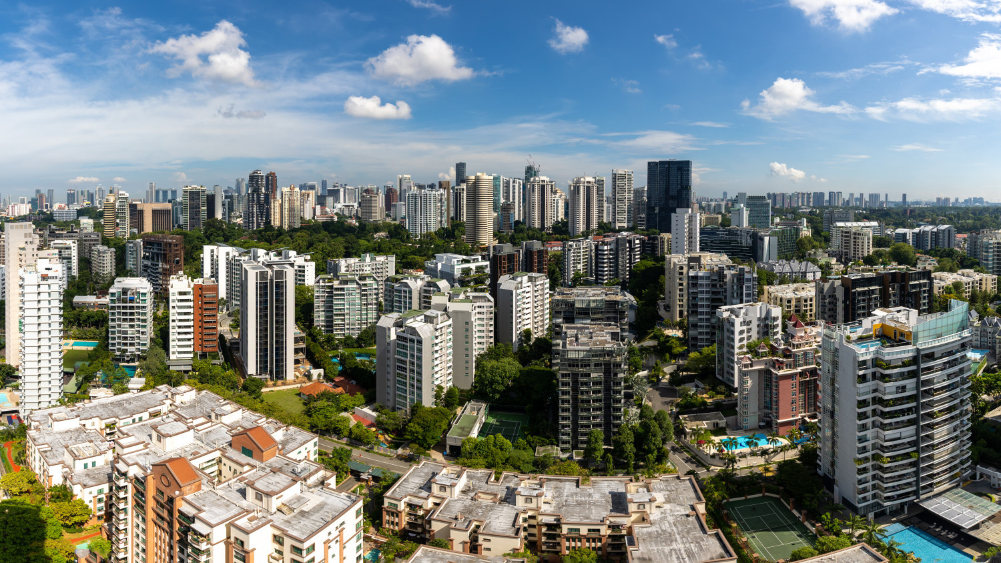
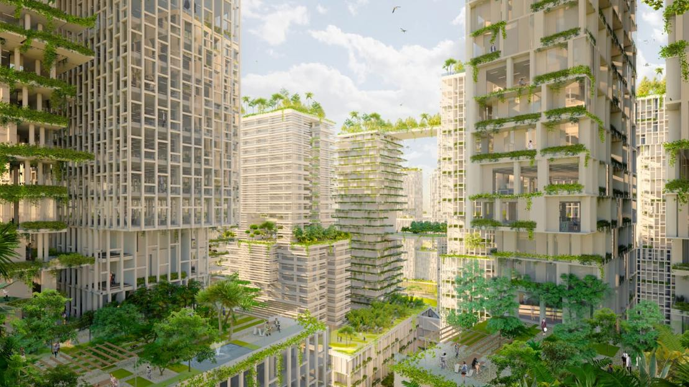
MARKET SEGMENTATION // 01
Price Ranges by Region
CCR (PRIME)
RCR (CITY FRINGE)
OCR (SUBURBAN)
Core Central Region
Rest of Central Region
Outside Central Region
Prime districts (9, 10, 11) and Downtown Core. Ultra-luxury segment with prices typically exceeding USD 2,000 psf.
City-fringe areas like Tiong Bahru and Queenstown. High demand from professionals, with prices between USD 1,500 - 2,000 psf.
Mass-market residential hubs like Jurong and Tampines. Strong local demand, with prices between USD 1,000 - 1,400 psf.
PAGE: 17
Notes:
These three regions also differ significantly in terms of price levels.
The Core Central Region represents the luxury segment of the market. Prices here often exceed USD 2,000 per square foot, particularly in prime districts like Orchard and Marina Bay.
The Rest of Central Region typically sits in the mid-tier segment, with prices roughly between USD 1,500 and USD 2,000 per square foot.
These areas tend to attract both investors and expatriate tenants because they offer good accessibility to the city centre.
The Outside Central Region represents the more mass-market segment of private housing.
Prices here are generally lower, around USD 1,000 to USD 1,400 per square foot, making them more accessible entry points for investors.
Understanding these regional differences is important because each segment has different risk-return dynamics.

Slide 18

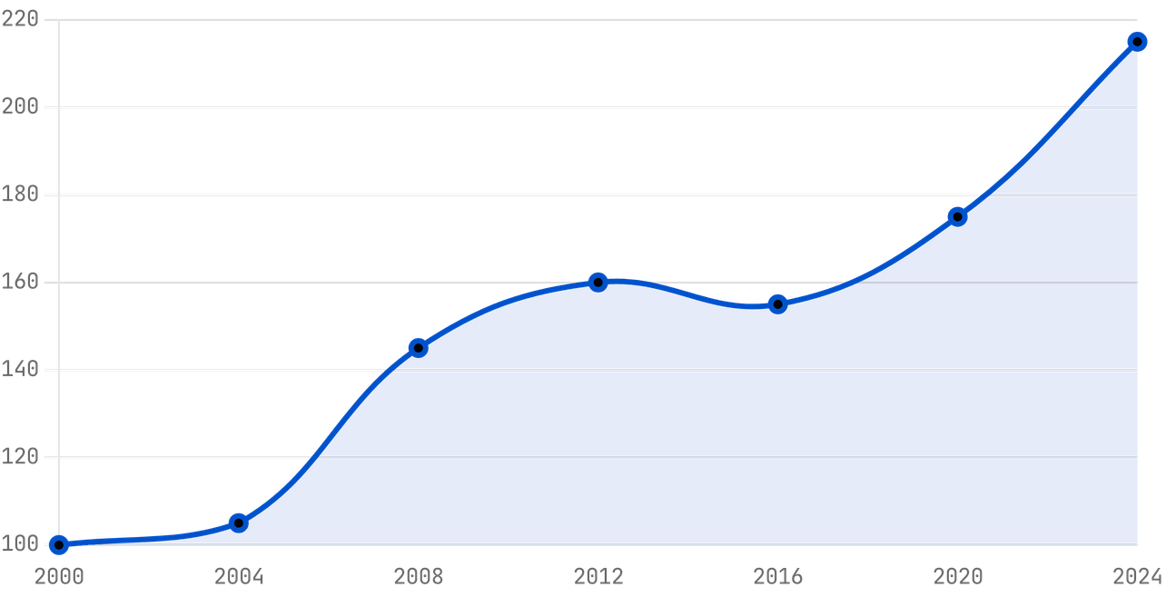
MARKET PERFORMANCE // TRENDS-01
Long-term Price Trends
PROPERTY_PRICE_INDEX_HISTORICAL
MARKET_CYCLE_ANALYSIS
2008 - 2009
Global Financial Crisis Correction
A sharp but brief correction followed by a rapid recovery driven by global liquidity and low interest rates.
2013 - 2017
Policy-Led Moderation
Introduction of TDSR and multiple ABSD hikes led to a sustained 4-year gradual price softening.
2021 - 2025
Post-Pandemic Resilience
SOURCE: URA REALIS / DATA NORMALIZED TO 2000 BASELINE
Supply constraints and a "flight to safety" drove significant price growth, prompting further cooling measures in 2023.
PROJECT: SG-RE-2026
PAGE: 15
Notes:
Historically, Singapore’s residential property market has demonstrated long-term price resilience.
Even during major global events, such as the Global Financial Crisis in 2008 or the COVID pandemic, prices experienced corrections but eventually recovered.
One key reason for this stability is government policy intervention.
When prices rise too quickly, the government often introduces cooling measures such as higher stamp duties or stricter loan limits.
These measures tend to moderate price growth and prevent speculative bubbles.
Looking ahead, the current outlook suggests a period of stabilization rather than rapid price increases, due to higher interest rates and supply adjustments

Slide 19




MARKET PERFORMANCE // YIELDS-01
Typical Rental Yields
GROSS_YIELD_BENCHMARKS
NET_YIELD_REALITY
REGION
EST. GROSS YIELD
Operating Expenses
Property tax, maintenance fees, and agency commissions typically compress gross yields by 0.8% - 1.2%.
Core Central (CCR)
2.5% - 3.2%
City Fringe (RCR)
3.2% - 3.7%
Net Yield Expectation
Investors should model for a net yield of 1.8% - 2.8% depending on the leverage and tax profile.
Suburban (OCR)
3.7% - 4.2%
Stability Premium
Lower yields are often offset by high occupancy rates (typically >95%) and a stable, high-quality tenant base.
PAGE: 19
Notes:
Rental yields in Singapore are generally considered moderate compared to some global real estate markets.
In the Core Central Region, yields are usually around 2.5 to 3.2 percent.
In the Rest of Central Region, yields tend to be slightly higher, typically around 3.2 to 3.7 percent.
In the Outside Central Region, yields can reach around 3.7 to 4.2 percent.
However, these are gross yields, which do not account for operating costs.
Once property taxes, maintenance fees, and agent commissions are included, the net yield typically falls to around 1.8 to 2.8 percent.
For many investors, Singapore real estate is therefore viewed less as a high-yield asset and more as a long-term capital preservation investment.

Slide 20


RENTAL MARKET // 03
Rental Driver: Global Talent & MNC Hubs
Regional HQ Dominance
Singapore hosts the regional headquarters for over 80% of the top 100 global tech firms, driving a consistent influx of high-income expatriate talent.
High-Income Expat Demand
The presence of global MNCs creates a robust rental market for high-end condominiums in prime districts and city-fringe business hubs.
Proximity to Business Hubs
Rental demand is highly concentrated around key business districts like the CBD, One-North, and Mapletree Business City.
PAGE: 20
Notes:
One of the main drivers of rental demand in Singapore is the presence of multinational corporations and global talent.
Singapore hosts regional headquarters for many of the world’s largest technology and financial companies.
This creates a steady flow of high-income expatriates relocating to Singapore for work.
These professionals typically prefer high-quality condominium developments, particularly in city-fringe or central locations.
As a result, areas close to major business hubs such as the CBD, One-North, and Mapletree Business City tend to see strong rental demand.
This expatriate demand plays a significant role in supporting rental occupancy rates

Slide 21
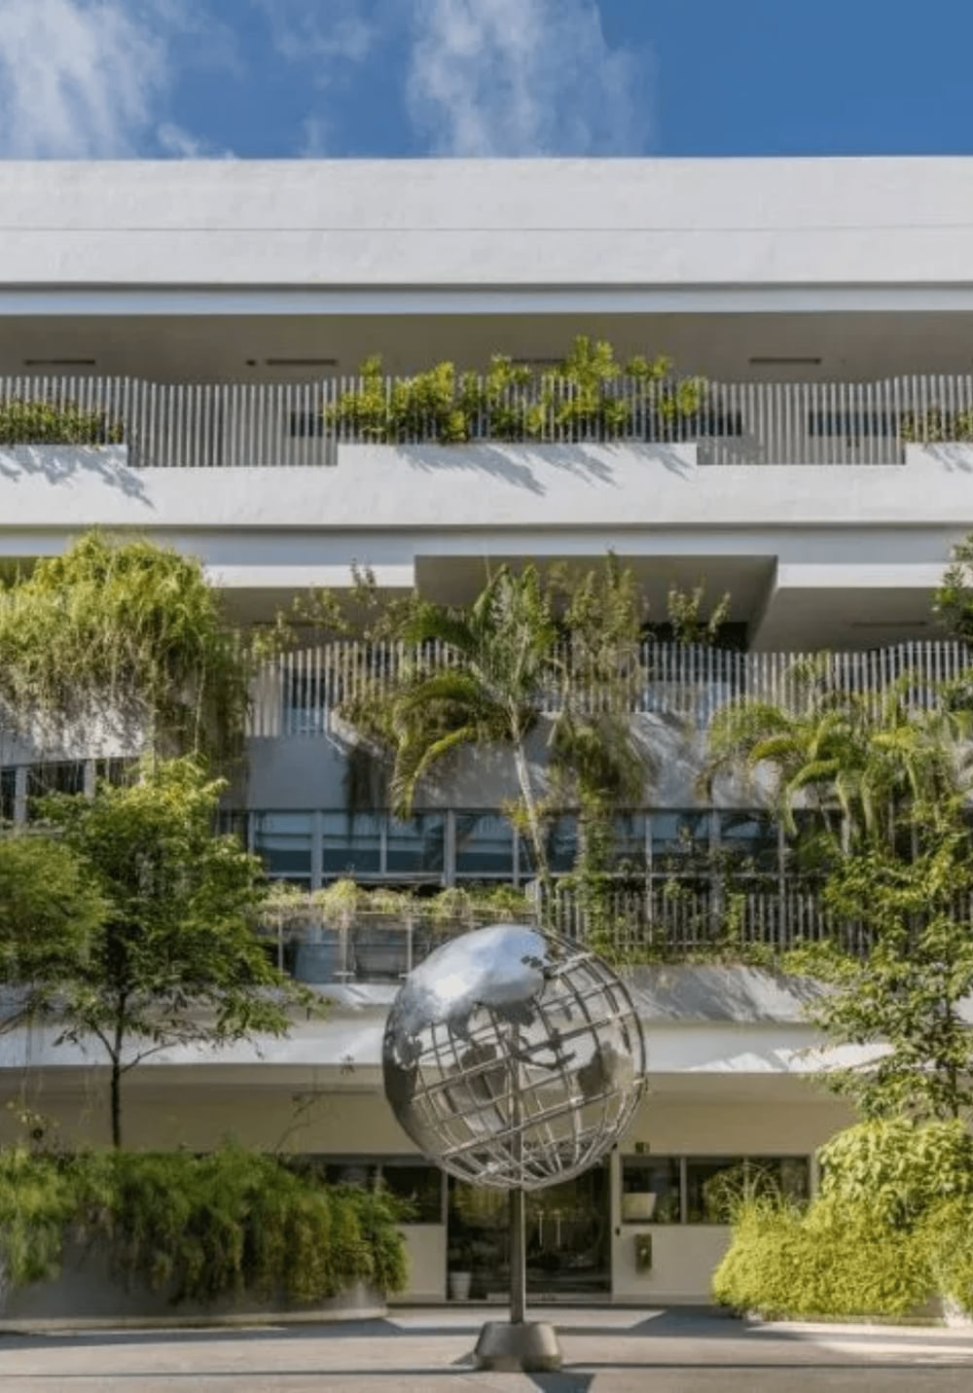
RENTAL MARKET // 04
Rental Driver: Education & International Schools
Global Education Hub
Singapore hosts over 60 international schools, attracting expatriate families from around the world who prioritize proximity to top-tier education.
Long-Term Family Demand
Families with children in international schools represent a stable, long-term rental segment, often committing to 2-3 year leases.
District Concentration
Rental demand is highly concentrated in districts with major school clusters, such as Bukit Timah (D10, D11) and Clementi (D21).
PAGE: 21
Notes:
Another major driver of rental demand comes from international education.
Singapore hosts more than 60 international schools, attracting expatriate families from around the world.
Families relocating to Singapore often prioritize proximity to reputable schools when choosing where to live.
This creates strong rental demand in certain districts with major school clusters.
Examples include Bukit Timah and Clementi, which host several well-known international schools.
Families with school-going children also tend to stay longer, often signing leases of two to three years.
This creates a relatively stable segment of the rental market.

Slide 22

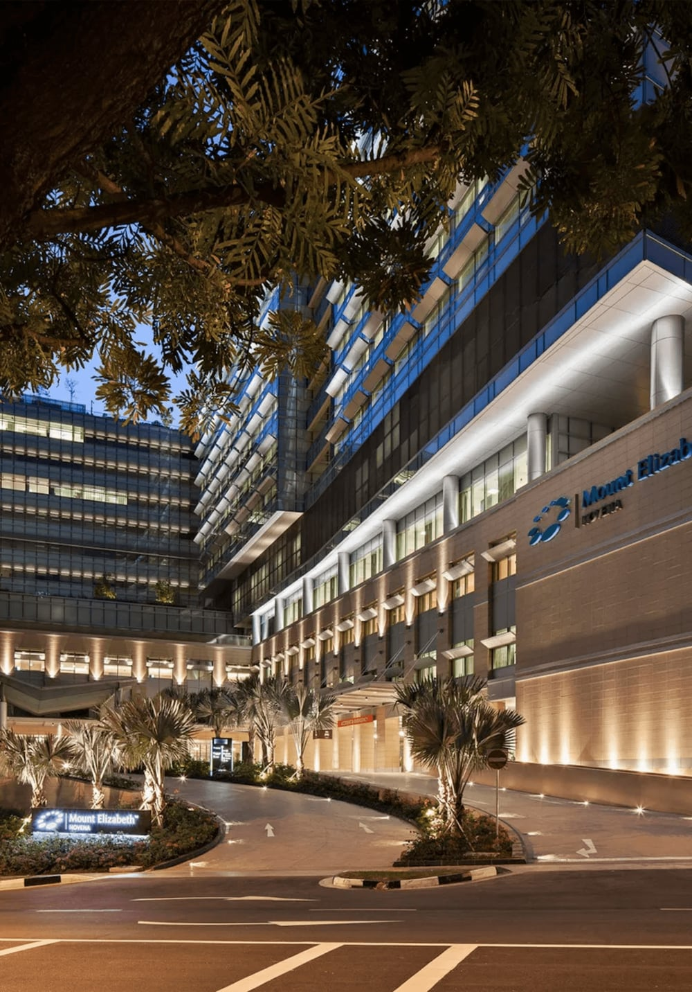
RENTAL MARKET // 05
Rental Driver: Healthcare & Medical Tourism
Regional Medical Hub
Singapore is a leading destination for high-end medical tourism in Southeast Asia, attracting patients and professionals from across the region.
Niche Rental Demand
Medical tourism creates demand for short-to-medium term rentals in specific districts with major medical clusters like Novena (D11) and Orchard (D9).
Specialized Infrastructure
The concentration of world-class hospitals and specialist centers drives consistent demand for residential units within walking distance of these hubs.
PAGE: 22
Notes:
Singapore is also a leading medical hub in Southeast Asia.
Many international patients travel to Singapore for advanced medical treatments.
This creates a niche segment of short- to medium-term rental demand, particularly for patients and visiting medical professionals.
Rental demand is often concentrated around major medical clusters such as Novena and Orchard.
Hospitals like Mount Elizabeth and Tan Tock Seng attract both international patients and healthcare professionals.
While this segment is smaller compared to expatriate demand, it still contributes to overall rental market stability.

Slide 23




INVESTMENT POTENTIAL // GROWTH-01
Capital Appreciation Potential
DRIVER_01
DRIVER_02
DRIVER_03
Supply Control
Infrastructure
Wealth Inflow
The government's tight control over land release through the GLS program ensures that supply rarely outstrips demand, providing a floor for property values.
Strategic investments in MRT expansions, regional business hubs (e.g., Jurong Lake District), and urban rejuvenation projects drive localized appreciation.
Singapore's status as a global wealth management hub continues to attract family offices and HNWIs, sustaining demand for premium residential assets.
> IMPACT: VALUE PRESERVATION
> IMPACT: LOCALIZED UPSIDE
> IMPACT: LONG-TERM GROWTH
PROJECT: SG-RE-2026
PAGE: 23
Notes:
Beyond rental income, many investors are interested in long-term capital appreciation.
One key driver is the government’s control over land supply through the Government Land Sales program.
By carefully regulating land release, the government helps ensure that supply does not dramatically exceed demand.
Another important factor is infrastructure development, such as new MRT lines and regional business hubs.
For example, projects like the Jurong Lake District are expected to transform entire regions of the city.
Finally, Singapore’s position as a global wealth management hub continues to attract high-net-worth individuals and family offices.
This inflow of capital supports long-term property demand, particularly in the premium residential segment.

Slide 24




REGULATORY FRAMEWORK // LEGAL-01
Legal & Tax Framework Overview
FRAMEWORK_01
FRAMEWORK_02
FRAMEWORK_03
Stamp Duties
Ownership Rights
Tax Compliance
The primary entry tax for property acquisition. Includes Buyer's Stamp Duty (BSD) and the significant Additional Buyer's Stamp Duty (ABSD) for foreign investors.
Clearly defined property titles under the Torrens system. Ownership types include Freehold, 999-year leasehold, and the more common 99-year leasehold.
Ongoing obligations including annual Property Tax and Income Tax on rental earnings. Singapore maintains a transparent and efficient tax filing system.
> FOCUS: ENTRY COSTS
> FOCUS: TITLE SECURITY
> FOCUS: HOLDING COSTS
PROJECT: SG-RE-2026
PAGE: 24
Notes:
Before investing in Singapore property, it’s important to understand the legal and tax framework.
One of the key entry costs is Buyer’s Stamp Duty, which applies to all property purchases.
In addition, foreign buyers are typically subject to Additional Buyer’s Stamp Duty, which is significantly higher.
Property ownership itself is governed under the Torrens title system, which ensures clear and secure ownership rights.
Investors must also consider ongoing obligations such as annual property taxes and income tax on rental earnings.
Overall, Singapore’s tax and legal system is generally considered transparent and efficient, but investors should still understand these costs before entering the market.

Slide 25

TAX FRAMEWORK // ABSD-01
Additional Buyer's Stamp Duty (ABSD)
STANDARD_FOREIGN_RATE
60%
FOR FOREIGN NATIONALS
As of April 2023, the standard ABSD rate for any residential property purchase by a foreign national is 60% of the purchase price or market value, whichever is higher.
This measure is designed to prioritize housing for citizens and manage the influx of foreign capital into the residential market.
PROJECT: SG-RE-2026
PAGE: 25
Notes:
One of the most important considerations for foreign investors in Singapore is Additional Buyer’s Stamp Duty, commonly referred to as ABSD.
As of the latest policy update, most foreign nationals purchasing residential property in Singapore are required to pay 60 percent ABSD on the purchase price.
This is in addition to the standard Buyer’s Stamp Duty that applies to all property transactions.
The policy was introduced primarily as a cooling measure to control speculative demand and maintain housing affordability for Singapore citizens.
Because the tax is so significant, it effectively discourages most foreign investors from entering the residential market unless they have a specific advantage or strategic reason.

Slide 26

TAX FRAMEWORK // FTA-01
US Citizens & the FTA Advantage
STANDARD_FOREIGN_INVESTOR
US_CITIZEN_ADVANTAGE
0%
60%
ABSD LIABILITY*
ABSD LIABILITY
Under the US-Singapore Free Trade Agreement (USSFTA), US Citizens are accorded the same treatment as Singapore Citizens.
Standard rate applicable to all foreign nationals and entities purchasing residential property in Singapore.
> *FOR THE FIRST RESIDENTIAL PROPERTY
PROJECT: SG-RE-2026
PAGE: 26
Notes:
However, there is one very important exception that applies specifically to US citizens.
Under the US-Singapore Free Trade Agreement, US citizens receive treatment similar to Singapore citizens for residential property purchases.
This means that US citizens do not have to pay the 60 percent ABSD on their first residential property purchase.
This exemption is unique and does not apply to most other foreign nationalities.
As a result, US investors effectively enjoy a major structural advantage when entering the Singapore residential market.

Slide 27
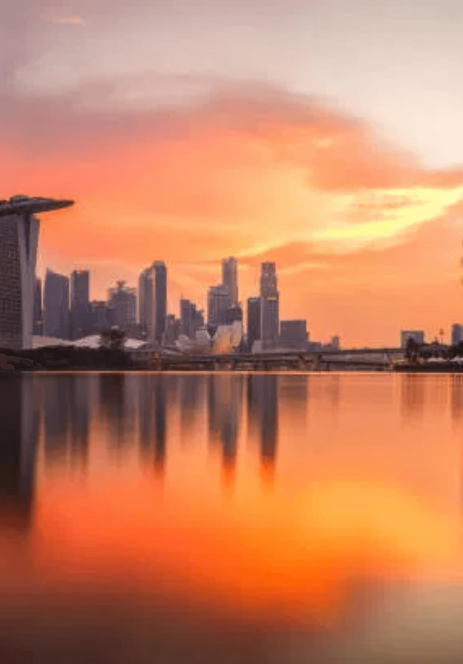
TAX FRAMEWORK // 03
The US-Singapore FTA Advantage
ABSD Remission for US Citizens
Under the US-Singapore Free Trade Agreement, US citizens are treated as Singapore citizens for ABSD purposes on their first residential property.
0% ABSD on First Property
While other foreigners pay 60% ABSD, US citizens pay 0% on their first residential purchase, providing a massive entry advantage.
Significant Capital Efficiency
This tax remission allows US investors to allocate more capital directly into the asset rather than into upfront taxes, enhancing overall ROI.
PAGE: 27
Notes:
The impact of this exemption is quite significant when we think about capital allocation.
For most foreign investors, the 60 percent ABSD would dramatically increase the upfront capital required for a purchase.
But for US citizens, that cost is eliminated for the first property.
This means that a much larger portion of the investor’s capital can be allocated directly into the asset itself rather than into taxes.
From an investment perspective, this improves overall capital efficiency and potential returns.
In many cases, this tax advantage is the key reason why US investors seriously consider Singapore property.

Slide 28



HOLDING COSTS // TAX-01
Annual Property Tax Rates (2026)
NON-OWNER-OCCUPIED_RESIDENTIAL_RATES
TAX_CALCULATION_LOGIC
ANNUAL VALUE (AV) BAND
TAX RATE
Annual Value (AV)
The AV is the estimated gross annual rent of the property if it were to be rented out, excluding furniture and maintenance fees.
First $30,000
12%
Next $15,000
20%
Next $15,000
28%
Annual Revision
IRAS reviews the AV of properties annually to reflect changes in market rental values.
Next $15,000
36%
Above $75,000
36%
Progressive Structure
Higher-value properties are taxed at higher marginal rates, reinforcing the progressive nature of Singapore's tax system.
PROJECT: SG-RE-2026
PAGE: 28
Notes:
In addition to upfront taxes, investors should also understand the ongoing property tax structure.
Property tax in Singapore is calculated based on something called the Annual Value, which is essentially the government’s estimate of the rental income the property could generate.
The tax rates are progressive, meaning higher-value properties are taxed at higher marginal rates.
For investment properties that are not owner-occupied, the tax rates range roughly between 12 percent and 36 percent depending on the Annual Value band.
These taxes are reassessed periodically by the tax authority to reflect changes in market rental values.

Slide 29



HOLDING COSTS // MAINTENANCE-01
Maintenance & Management Costs
ESTIMATED_MONTHLY_FEES
MANAGEMENT_STRUCTURE
UNIT TYPE
TYPICAL RANGE (USD)
Service Fund
Covers day-to-day operations: 24/7 security, cleaning, landscaping, and maintenance of common facilities (pool, gym).
1-Bedroom
$230 - $350
2-Bedroom
$350 - $470
Sinking Fund
A reserve fund for long-term capital expenditures, such as repainting, lift replacements, and major structural repairs.
3-Bedroom
$470 - $670
MCST Governance
Managed by the Management Corporation Strata Title (MCST), ensuring professional oversight and value preservation.
PROJECT: SG-RE-2026
PAGE: 29
Notes:
For condominium properties, investors also need to account for monthly maintenance fees.
These fees typically range from around 300 to 850 Singapore dollars per month depending on the unit size.
The fees cover the operation and maintenance of shared facilities such as swimming pools, gyms, landscaping, and security.
Condominiums are managed by a governing body known as the Management Corporation Strata Title, or MCST.
The MCST oversees building management and maintains both the service fund and sinking fund, which ensure long-term upkeep of the property

Slide 30

INVESTMENT STRATEGY // FINANCING-01
Financing for Foreign Investors
LOAN-TO-VALUE_LIMITS
MORTGAGE_AVAILABILITY
RESIDENTIAL PROPERTY
MAX LTV
Income Verification
Foreigners must provide proof of stable income, typically through tax returns or employment contracts, for credit assessment.
1st Property
Up to 75%
2nd Property
Up to 45%
Loan Tenure
Maximum tenure is 30 years for non-landed residential property, capped by the borrower's age (typically 65).
3rd Property+
Up to 35%
Interest Rates
Mortgage rates in Singapore are generally linked to SORA (Singapore Overnight Rate Average) plus a bank margin.
PROJECT: SG-RE-2026
PAGE: 30
Notes:
Foreign investors can also obtain mortgage financing from Singapore banks, although lending rules are regulated.
For a first residential property, the maximum loan-to-value ratio is typically up to 75 percent.
For second or subsequent properties, the allowable leverage is reduced.
Banks will typically require proof of income, such as tax returns or employment documentation, when evaluating loan applications.
Mortgage rates in Singapore are usually linked to the Singapore Overnight Rate Average, or SORA, plus a bank margin.
Loan tenures are generally capped at 30 years or until the borrower reaches around age 65

Slide 31



RISK ASSESSMENT // FACTORS-01
Key Risk Factors
RISK_01
RISK_02
RISK_03
Policy Risk
Interest Rate Risk
Currency Risk
The Singapore government actively intervenes to prevent market bubbles. Sudden changes in stamp duties or loan limits can impact liquidity and entry/exit costs.
Singapore's interest rates are highly correlated with US Fed cycles. Rising rates increase mortgage servicing costs and can compress net rental yields.
For US-based investors, fluctuations in the USD/SGD exchange rate can impact the total return on investment when repatriating funds.
> IMPACT: FINANCING COSTS
> IMPACT: TOTAL RETURNS
> IMPACT: MARKET LIQUIDITY
PROJECT: SG-RE-2026
PAGE: 31
Notes:
As with any investment, there are several key risks investors should be aware of.
The first is policy risk. Singapore’s government actively intervenes in the housing market, so regulatory changes can affect investment dynamics.
The second is interest rate risk, particularly since Singapore’s interest rates tend to move in line with US Federal Reserve policy.
Higher interest rates increase borrowing costs and may compress rental yields.
The third is currency risk. For US-based investors, fluctuations in the USD-SGD exchange rate can influence overall investment returns

Slide 32


EXIT STRATEGY // LIQUIDITY-01
Market Liquidity & Exit Strategies
SECONDARY_MARKET_DYNAMICS
SELLER'S_STAMP_DUTY_(SSD)
High Transparency
HOLDING PERIOD
SSD RATE
Transaction data is publicly available via URA REALIS, ensuring price discovery and market efficiency for both buyers and sellers.
Up to 1 Year
12%
More than 1 to 2 Years
8%
Standardized Process
More than 2 to 3 Years
4%
The resale process is highly standardized with clear legal timelines, reducing transaction friction and execution risk.
More than 3 Years
0%
Holding Period
Recommended holding period of 5-10 years to ride out market cycles and maximize capital appreciation potential.
SSD is calculated based on the selling price or market value, whichever is higher. It is designed to curb short-term speculative flipping.
PROJECT: SG-RE-2026
PAGE: 32
Notes:
One advantage of Singapore’s property market is its high level of transparency.
Transaction prices are publicly available through the URA REALIS database, which allows investors to observe real market activity.
The resale process is also highly standardized and regulated.
Investors typically adopt a holding period of around five to ten years, which allows them to ride through property cycles.
There is also something called Seller’s Stamp Duty, which discourages short-term speculation by imposing taxes on properties sold within the first few years

Slide 33
TRANSACTION WORKFLOW // PROCESS-01
The Purchase Process: Step 1-2
INITIAL_COMMITMENT
LEGAL_EXECUTION
01
Option to Purchase (OTP)
02
Sales & Purchase Agreement
Payment of 1% Option Fee to the seller in exchange for the OTP document.
Buyer exercises the OTP by signing the Sales & Purchase (S&P) Agreement.
Grants the buyer the exclusive right to purchase the property for a fixed period (typically 14 days).
Payment of the remaining 4% (or 9% for some cases) Exercise Fee to the seller's lawyer.
The seller is legally barred from offering the property to other parties during this period.
Buyer's lawyer lodges a caveat on the property to protect the buyer's interest.
PROJECT: SG-RE-2026
PAGE: 33
Notes:
Slide pointers
Buyer pays 1% option fee to secure the property and receives the Option to Purchase (OTP).
OTP grants the buyer exclusive rights to purchase the property for typically 14 days.
During this period the buyer conducts legal checks and secures mortgage financing.
To proceed, the buyer exercises the OTP and pays the balance of the 5% deposit.
The Sale & Purchase Agreement becomes legally binding once the option is exercised.
Speaker notes (optional if you want)
This stage essentially locks in the transaction and commits both parties legally

Slide 34


TRANSACTION WORKFLOW // PROCESS-02
The Purchase Process: Steps 3-4
STEP_03
STEP_04
Completion of Sale
Handover & Possession
The final legal transfer of the property. Your lawyer will coordinate the payment of the remaining 75% of the purchase price (via cash or mortgage) to the seller's lawyer.
The title deed is officially registered in your name with the Singapore Land Authority (SLA).
Upon completion, you receive vacant possession of the property and collect the keys.
For new developments (BUC), this is followed by a 12-month Defects Liability Period where the developer is responsible for rectifying any construction flaws.
> TIMELINE: 8-12 WEEKS POST-OTP
> STATUS: TRANSACTION COMPLETE
PROJECT: SG-RE-2026
PAGE: 34
Notes:
After exercising the OTP, the transaction proceeds toward legal completion.
Lawyers coordinate documentation, mortgage arrangements, and fund transfers.
The buyer pays the remaining purchase amount through cash and bank financing.
Ownership is formally registered with the Singapore Land Authority (SLA).
Completion typically occurs 8–12 weeks after the OTP is exercised.
Buyer receives vacant possession and keys to the property.

Slide 35



LEGAL OVERSIGHT // REPRESENTATION-01
The Role of Legal Representation
PILLAR_01
PILLAR_02
PILLAR_03
Due Diligence
Financial Escrow
Legal Transfer
Lawyers conduct comprehensive title searches to ensure the property is free from encumbrances and that the seller has the legal right to sell.
All transaction funds are held in specialized conveyancing accounts (escrow) regulated by the Law Society, ensuring funds are only released upon completion.
Preparation and execution of all legal documents, including the S&P Agreement and the official transfer of title with the Singapore Land Authority.
> TASK: TITLE VERIFICATION
> TASK: FUND PROTECTION
> TASK: TITLE REGISTRATION
PROJECT: SG-RE-2026
PAGE: 35
Notes:
Lawyers play an important role in Singapore property transactions.
They conduct due diligence checks on the property title, ensuring there are no legal encumbrances.
Transaction funds are typically held in regulated conveyancing accounts, which protect both buyer and seller during the process.
Lawyers also prepare and file all legal documents required for the transfer of ownership

Slide 36


CASE STUDY // SETUP-01
Case Study: Example Investment Setup
PROPERTY_PROFILE
FINANCIAL_ENTRY_PARAMETERS
Asset Type
Purchase Price
SGD 2,000,000
Private Condominium (Resale), 2-Bedroom Unit
Price Per Sq Ft
SGD 2,500
Location
Buyer's Stamp Duty (BSD)
SGD 69,600
Rest of Central Region (RCR) - City Fringe
ABSD (US Citizen - 1st Prop)
SGD 0
Size
Total Entry Capital*
SGD 2,069,600
800 sq ft (74 sqm)
*Excluding legal fees and valuation costs. Conversion rate: ~USD 1.5M.
PROJECT: SG-RE-2026
PAGE: 36
Notes:
To illustrate how these numbers work in practice, let’s look at a simple investment example.
In this case, we assume the purchase of a two-bedroom condominium unit in the city fringe region.
The purchase price is assumed to be around two million Singapore dollars, which is approximately 1.5 million US dollars.
Because the investor is a US citizen, the ABSD is zero for the first property purchase, which significantly reduces the upfront capital requirement.

Slide 37

CASE STUDY // FINANCIALS-01
Financial Model Breakdown
INVESTMENT_LEDGER_(SGD)
YIELD_PERFORMANCE
ITEM
AMOUNT
3.48%
Purchase Price (RCR 2-BR)
2,000,000
Buyer's Stamp Duty (BSD)
64,600
GROSS YIELD
ABSD (US Citizen / 1st Property)
0
Legal & Admin Fees (Legal, Valuation, Loan Processing, etc)
5,700
2.41%
TOTAL INITIAL OUTLAY
2,070,300
ANNUAL OPERATING MODEL
NET YIELD
Gross Rental Income ($5,800/mo)
69,600
> STRATEGIC ADVANTAGE: US Citizens avoid the 60% ABSD (SGD 1,200,000), significantly reducing the initial capital outlay and improving the cash-on-cash return compared to other foreign nationals.
Property Tax (Non-Owner Occupied)
(8,500)
Maintenance Fees ($600/mo)
(7,200)
Agency & Misc (Pro-rated)
(5,800)
NET OPERATING INCOME (NOI)
48,100
PROJECT: SG-RE-2026
PAGE: 37
Notes:
In this example, the property generates around 5,800 Singapore dollars in monthly rental income.
That results in approximately 69,600 dollars of gross rental income per year.
After accounting for property tax, maintenance fees, and other operating expenses, the net operating income is roughly 48,000 dollars annually.
This results in a gross yield of about 3.5 percent and a net yield of roughly 2.4 percent.
Again, the key advantage here is the absence of the 60 percent ABSD, which significantly improves the capital structure of the investment

Slide 38



FINANCIAL RESILIENCE // STRESS-TEST
Stress Test Scenario Analysis
SCENARIO_01
SCENARIO_02
SCENARIO_03
Interest Rate +2%
Rental Decline -15%
2-Month Vacancy
Assumes a significant spike in mortgage rates. This scenario tests the impact on monthly debt servicing and the resulting net cash flow position.
Assumes a market-wide softening of rental demand. This scenario evaluates the resilience of the net yield and the ability to cover holding costs.
Assumes an extended period between tenants. This scenario measures the impact of zero income for 16% of the year on the total annual ROI.
> IMPACT: CASH FLOW REDUCTION
> IMPACT: YIELD COMPRESSION
> IMPACT: ANNUAL ROI EROSION
PROJECT: SG-RE-2026
PAGE: 38
Notes:
Improved Speaker Notes
It’s important to evaluate how the investment performs not just under normal conditions, but also under less favorable market scenarios. Stress testing helps investors understand whether the property remains financially viable even when market conditions deteriorate.
The first scenario assumes interest rates increase by two percentage points. Since mortgage rates in Singapore are typically linked to benchmarks such as SORA, a significant rate increase would raise monthly loan repayments. This test examines how higher financing costs could affect the investor’s cash flow position.
The second scenario assumes a 15 percent decline in rental income. Rental markets can fluctuate depending on economic conditions, expatriate demand, or supply of new units entering the market. This scenario evaluates whether the property’s net yield remains sustainable even if rents soften.
The third scenario assumes a two-month vacancy period between tenants, which represents roughly 16 percent of annual rental income being lost. Vacancy risk can occur during tenant transitions or slower leasing periods, so this test measures how gaps in occupancy affect annual returns.
Together, these scenarios provide a simple way to assess the resilience of the investment, helping investors understand how the property might perform during periods of higher interest rates, weaker rental markets, or temporary vacancies.
“None of these scenarios are extreme on their own, but they help illustrate the main risks investors typically consider when evaluating rental property.”

Slide 39




MARKET OUTLOOK // 2026-01
2026 Market Outlook Summary
TREND_01
TREND_02
TREND_03
Price Stabilization
Rental Resilience
Safe Haven Status
Expect continued price moderation as government cooling measures and high interest rates balance demand. Growth is likely to be sustainable and policy-aligned.
Rental demand remains supported by the influx of global talent and corporate relocations, though yield compression may occur due to increased supply.
Singapore's role as a regional "flight to safety" destination will continue to attract long-term capital seeking institutional stability and currency strength.
> FORECAST: STABLE GROWTH
> FORECAST: HIGH OCCUPANCY
> FORECAST: SUSTAINED INFLOW
PROJECT: SG-RE-2026
PAGE: 39
Notes:
Looking ahead, the market outlook suggests moderate price stabilization rather than rapid growth.
Government cooling measures and interest rate levels are helping balance demand.
At the same time, rental demand remains supported by international talent and corporate relocations.
Singapore also continues to be viewed as a safe-haven destination for capital in Asia, particularly during periods of global uncertainty.

Slide 40

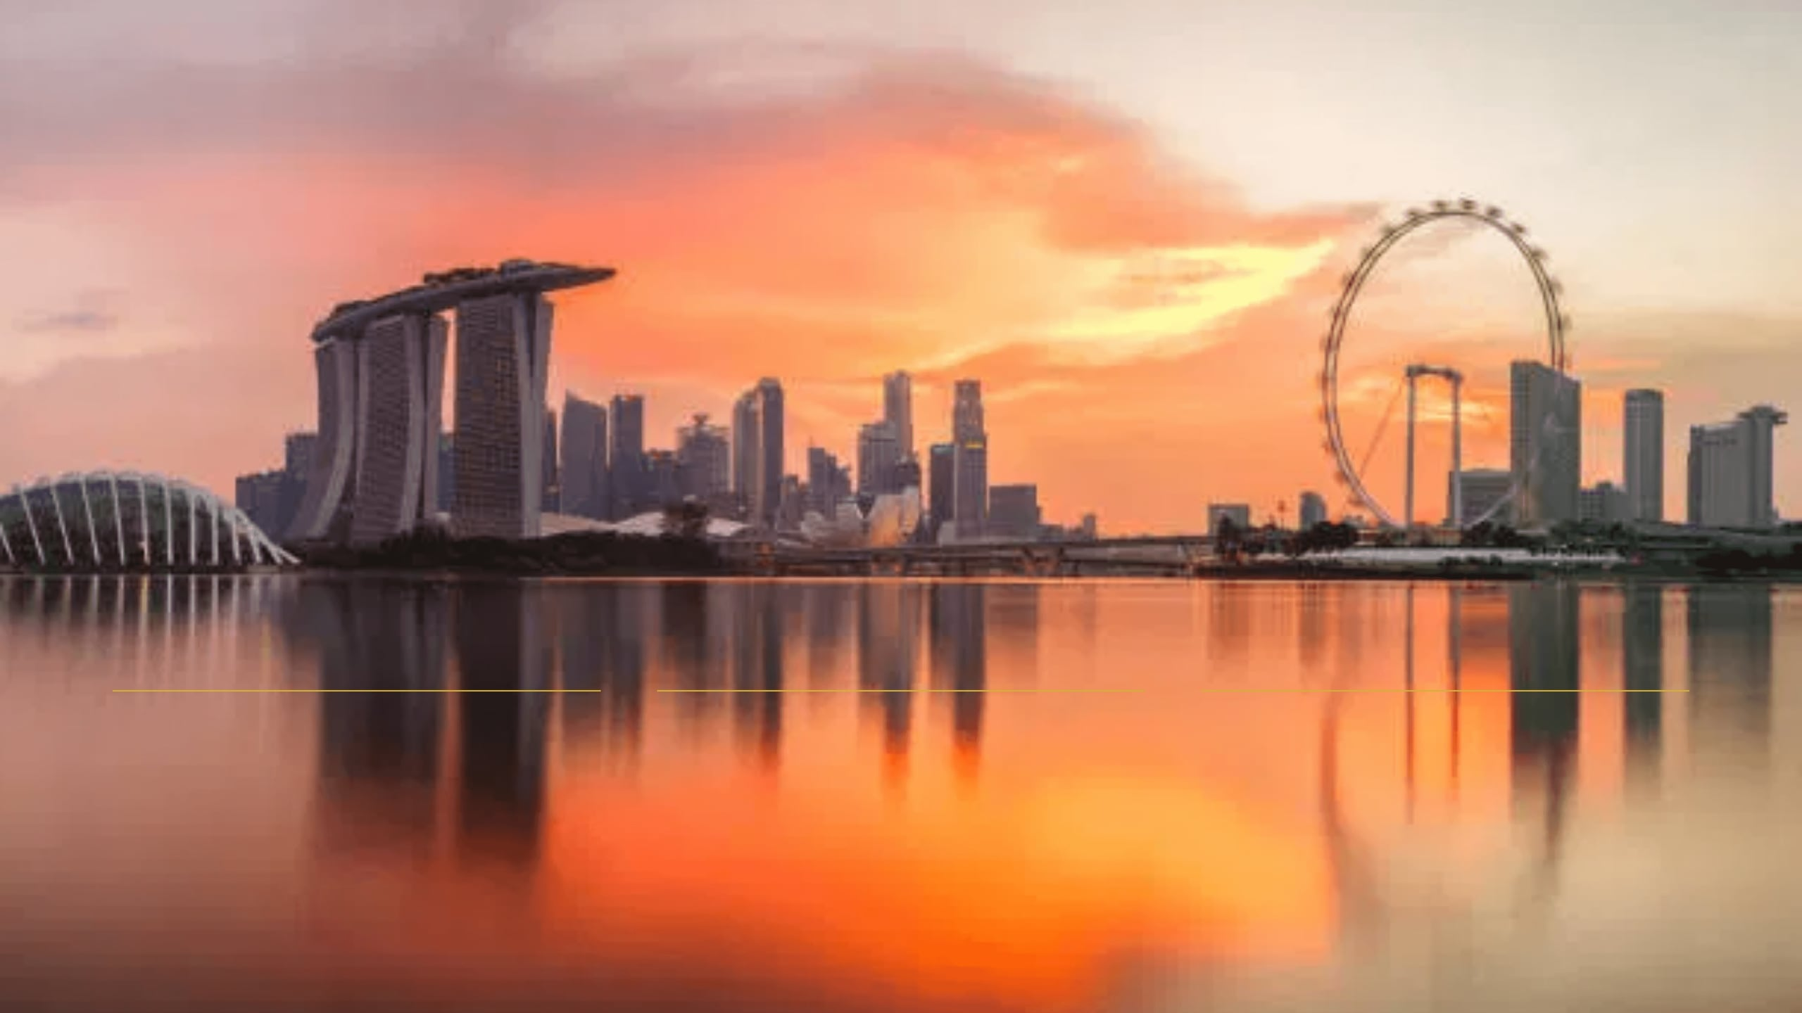
FINAL SUMMARY // 2026
Final Thoughts & Conclusion
Institutional Stability
Strategic Advantage
Long-Term Allocation
Singapore's primary value proposition remains its unparalleled legal transparency and political stability.
The US-Singapore FTA provides a unique entry advantage, bypassing significant tax barriers faced by others.
Real estate in Singapore is best viewed as a long-term, stability-oriented allocation in a global portfolio.
PAGE: 40
Notes:
To summarize, Singapore’s key strength lies in its institutional stability and strong legal framework.
The US-Singapore Free Trade Agreement creates a unique investment advantage for US citizens, particularly regarding stamp duties.
For most investors, Singapore real estate should be viewed as a long-term, stability-oriented allocation within a diversified global portfolio.
It may not always offer the highest yields, but it provides transparency, liquidity, and capital preservation that many global investors value.

Slide 41


Q&A // CONCLUSION-01
Q&A // CONCLUSION-02
Q&A + Contact Details
PAGE: 41

